Slide 1
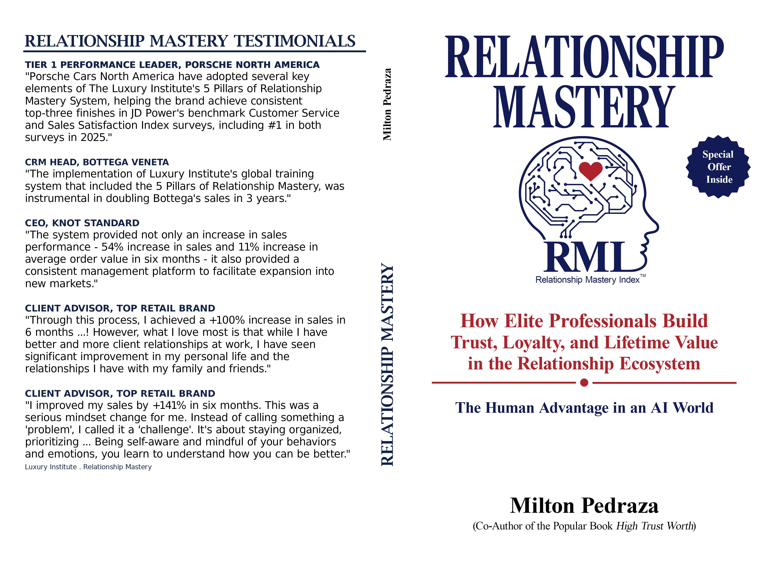
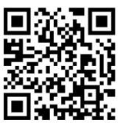
Now available in e-book and paperback on Amazon and e-book on
Apple Books
Audiobook will be available in June

Slide 2
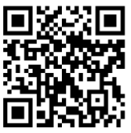
SCAN THIS QR CODE TO EMAIL JESSICA LAFFERTY TO ENTER THE RELATIONSHIP MASTERY
E-BOOK RAFFLE AND TO BE NOTIFIED WHEN THE AUDIOBOOK IS AVAILABLE
Contact to learn more about Relationship Mastery: Milton Pedraza Luxury Institute CEO mpedraza@luxuryinstitute.com Jessica Lafferty Luxury Institute Consultant jlafferty@luxuryinstitute.com

