Slide 1

Privacy, Security & The Off Market World

Slide 2
Noise
Private Listings
Office Exclusives
Whisper Inventory
Seller Privacy
MLS Policy
Zillow
Clear Cooperation
Notes:
NOISE:
Private Listings
Office Exclusives
Whisper Inventory
Seller Privacy
MLS Policy
Zillow, Clear Cooperation

Slide 3

The conversation is bigger than policy concerns.
There is a fundamental shift in
luxury consumer behavior.
Notes:
The conversation is
bigger than policy concerns.
There is a fundamental shift in
luxury consumer behavior.

Slide 4
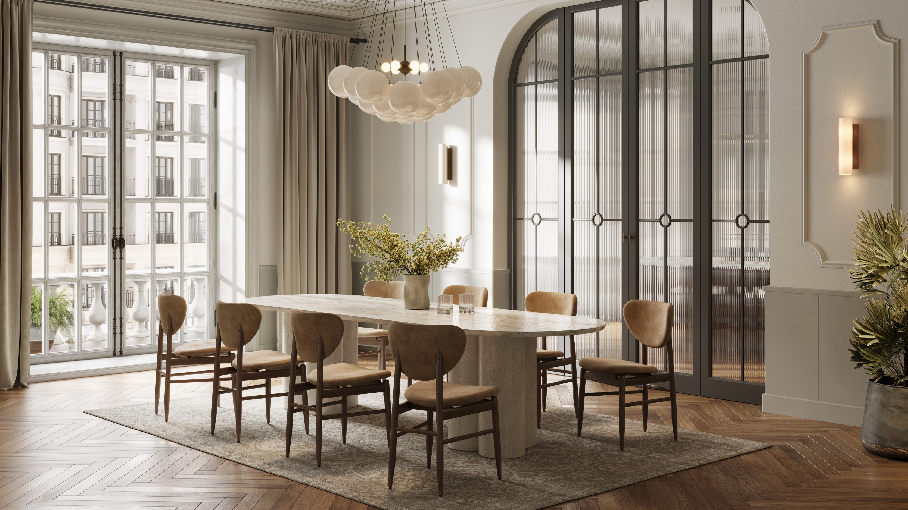

Selective Exposure versus
Indiscriminate Exposure
Notes:
Selective Exposure
versus
Indiscriminate Exposure

Slide 5
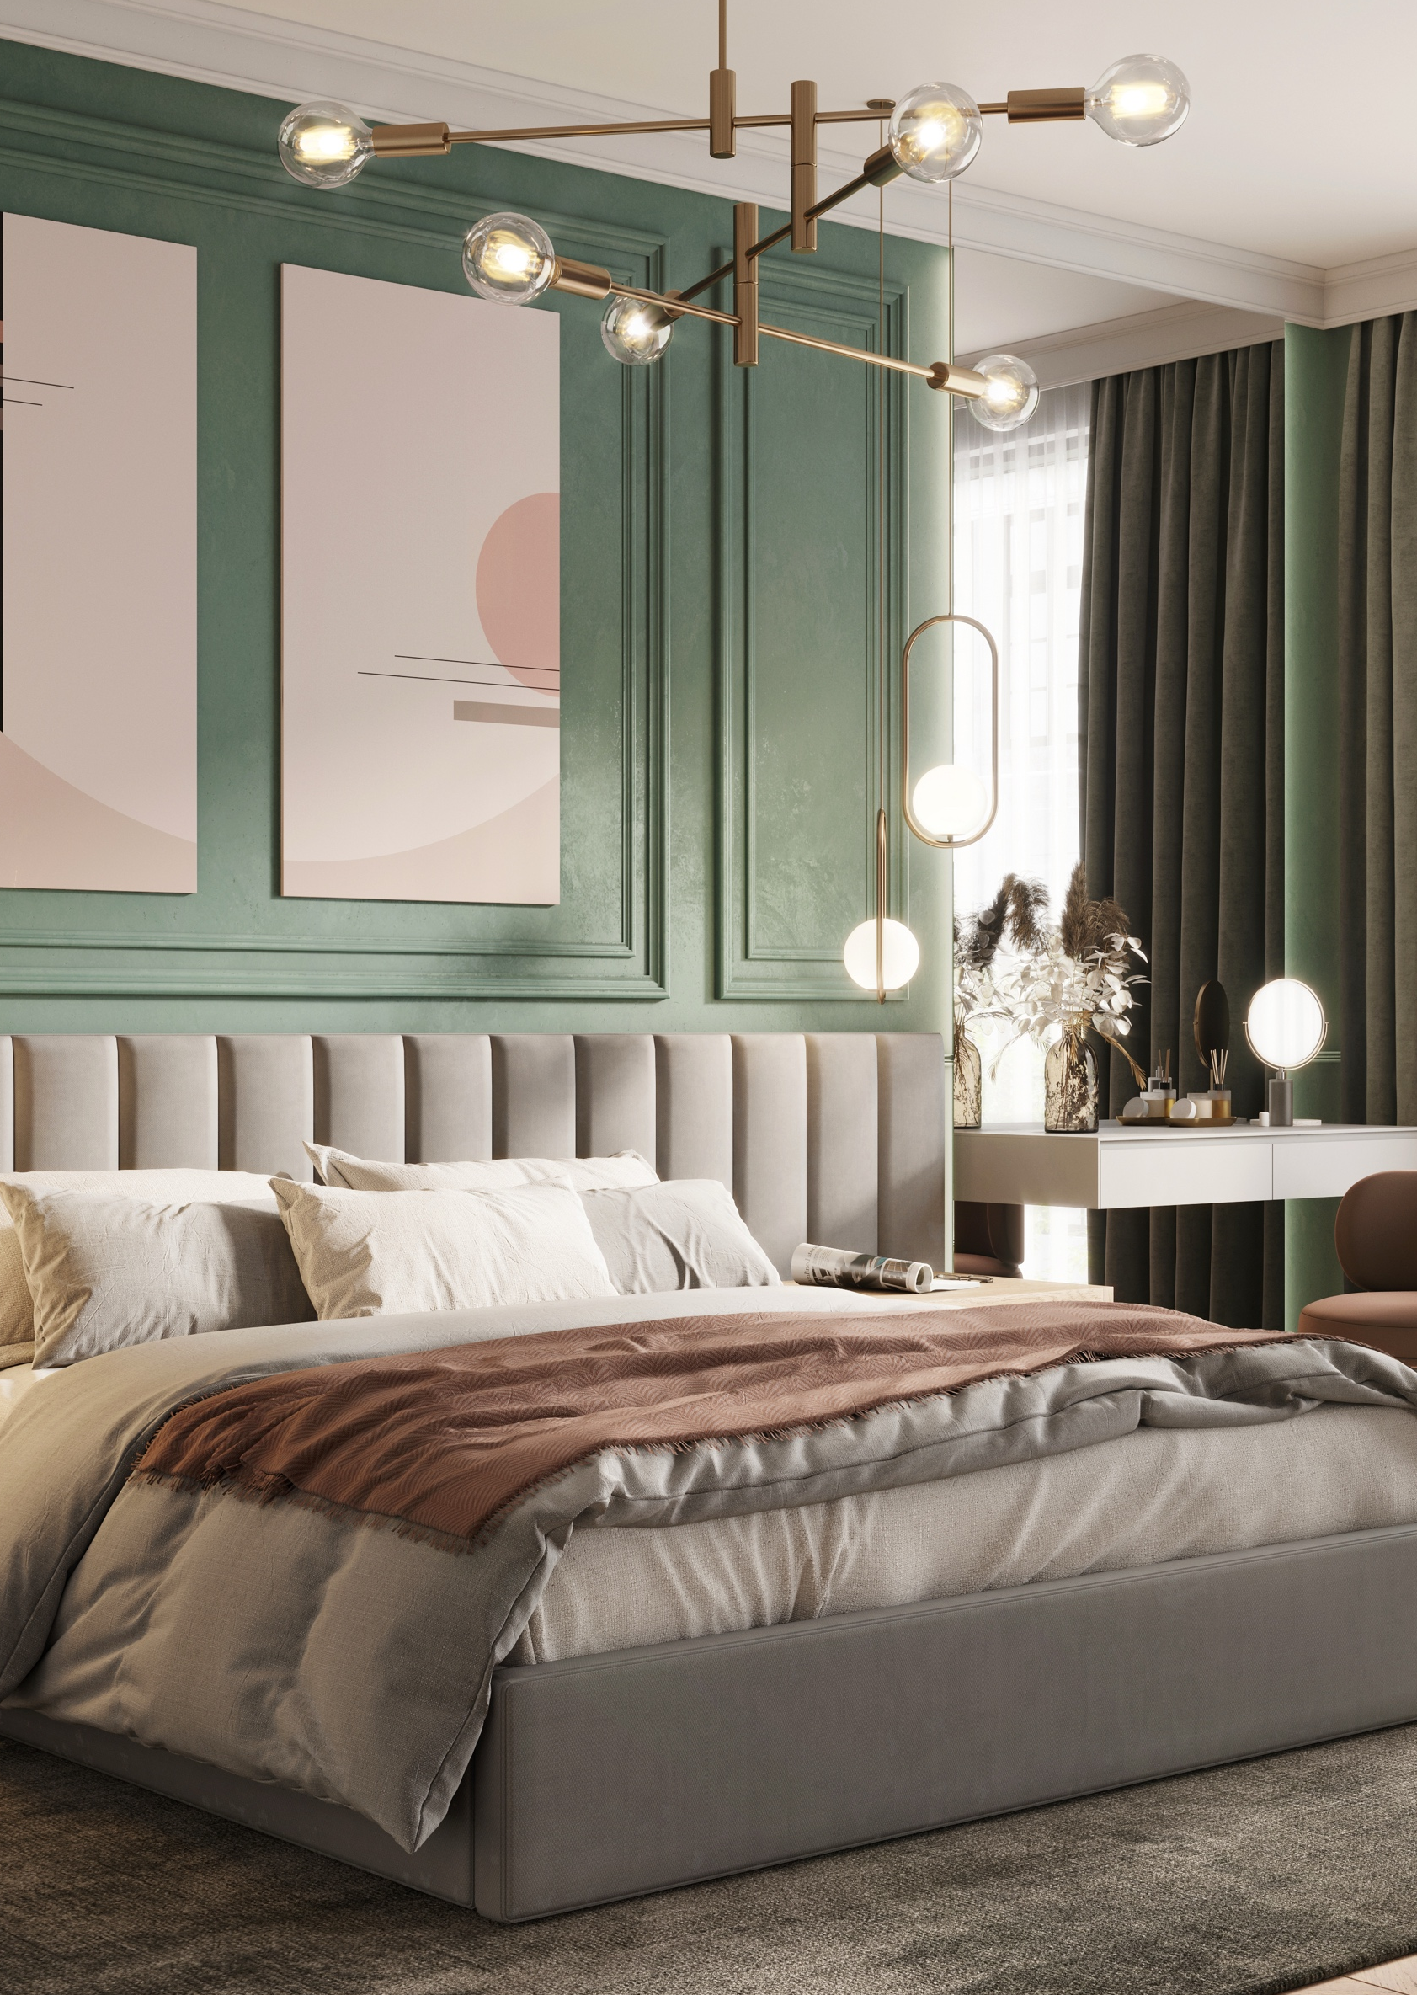
Selective exposure
Controlled visibility
Phased exposure
Curated demand
Strategic sequencing
Notes:
Selective exposure:
Controlled visibility
Phased exposure
Curated demand
Strategic sequencing

Slide 6

Controlling the
Narrative
Reputation protection
Executive visibility
Family security
Wealth signaling
Notes:
Controlling the
Narrative:
Reputation protection
Executive visibility
Family security
Wealth signaling

Slide 7
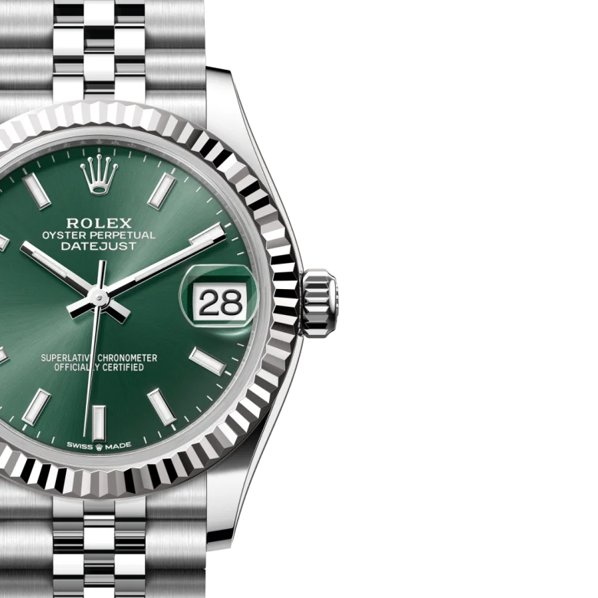




Curated Value
Luxury consumers assign greater value to what feels curated, controlled and scarce.
Notes:
Curated Value
Luxury consumers assign greater value to what feels curated, controlled and scarce.

Slide 8

Luxury as a Business
Modern luxury has shifted from selling products to providing high-quality access through:
Exclusive Relationship Networks
Curated Audience Engagement
Data
Notes:
Luxury has become a high-quality access business
Relationship networks
Curated audience engagement
Data
Car shown: Rolls-Royce Building 100 Very Exclusive Electric Cars
https://www.newsweek.com/first-look-rolls-royce-building-100-very-exclusive-electric-cars-11822936

Slide 9



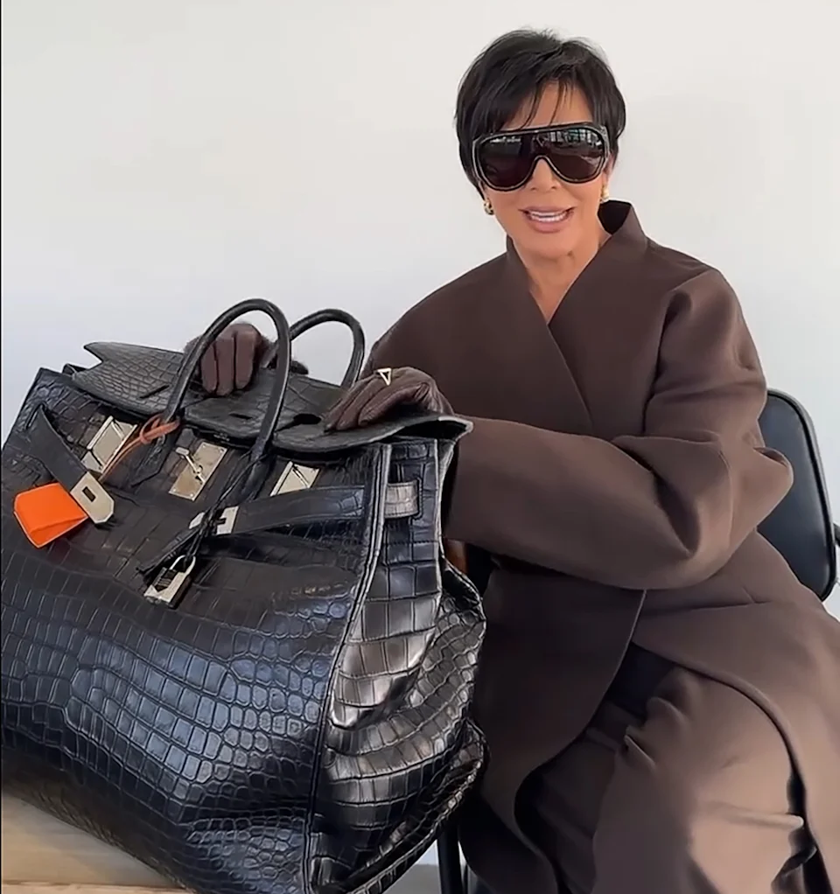
Three Phases of
Modern Luxury Marketing
Market Intelligence
Quiet Insights
Curated Demand
Scarcity Creating Conversations
Market Amplification
Broader Exposure with Momentum
Notes:
Three Phases of Modern Luxury Marketing:
Market Intelligence
Quiet Insights
Curated Demand
Scarcity creating conversations
Market Amplification
Broader exposure with momentum

Slide 10
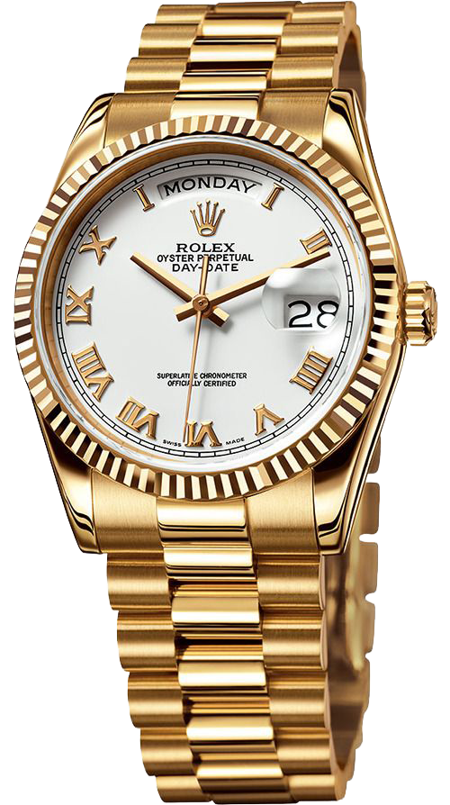
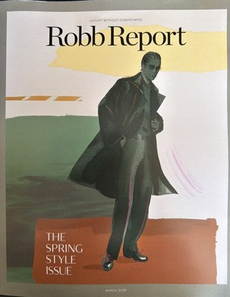




Tactical Strategies
Individualized, Lifestyle-First Marketing
Invitation Only Premiere Events
Wealth-Aligned Targeting
Notes:
Tactical Strategies:
Individualized Lifestyle-first marketing
Invitation only premiere events
Wealth-aligned targeting

Slide 11

Luxury Channel Alignment
Private aviation
Luxury automotive
Wealth management
Private clubs
Art Galleries
Preventive Ageing

Slide 12


A luxury service experience creates demand while respecting discretion

