Slide 1
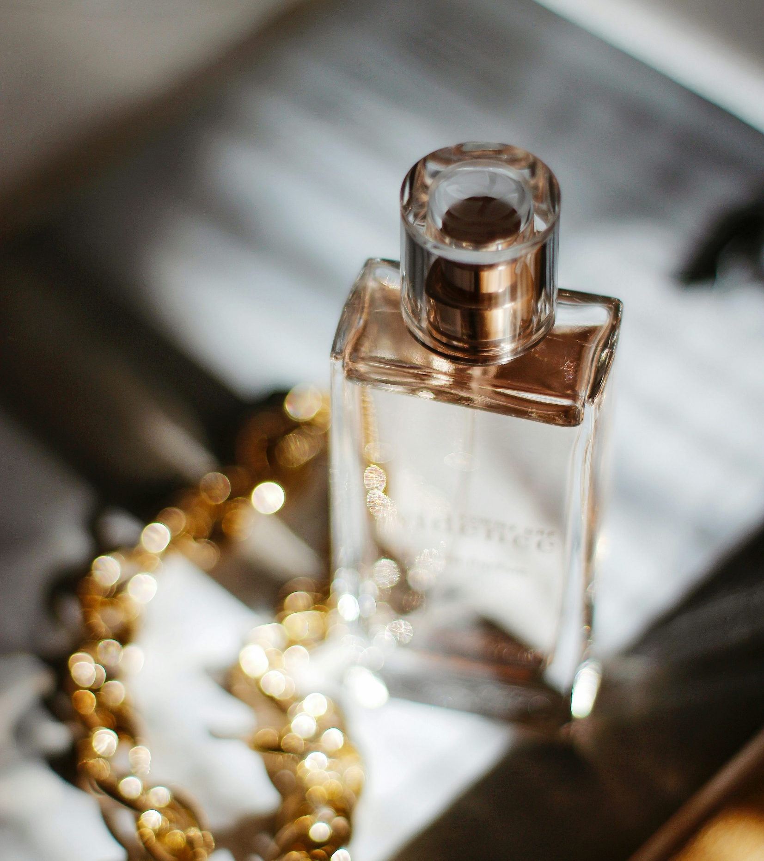
State of Luxury
From the lens of the Beauty consumer
April 2026

Slide 2

Beauty is where the luxury consumer's biggest shifts are showing up first, and most clearly
Beauty signal
Broader luxury implication
Beauty is one of the last things consumers cut, even when budgets tighten
46% plan to reduce discretionary spend, yet beauty remains protected
Categories with deep emotional resonance are more resilient than those built on aspiration alone
01
Even the highest-spending beauty consumers are actively questioning premium price tags
44–62% across all spending personas are actively seeking alternatives
The luxury value contract is under renegotiation at every tier
02
Beauty consumers are increasingly indifferent to who made it, they care about what it does
Only 22% prioritize brand heritage over performance
Brand equity alone is no longer a purchase trigger: Earned relevance > inherited prestige
03
The State of the Luxury Consumer: Seen Through Beauty
Beauty has become a wellness ritual, not a vanity purchase
Wellness is the #1 purchase driver across all personas (37–47%)
The emotional job-to-be-done has fundamentally shifted: Luxury consumers are buying meaning
04
Consumers no longer distinguish between channels, they bring the same expectations everywhere
Curation, community, experience and convenience are all important
The notion of a 'primary' luxury touchpoint is obsolete:
Every interaction is the brand
05
Insights in this presentation are built from (i) Kearney’s proprietary survey of 1,000 beauty consumers in the US & (ii) Kearney’s 2026 Global Luxury Industry Outlook report
Source: Kearney Prestige Beauty Consumer Index, January 2026

Slide 3
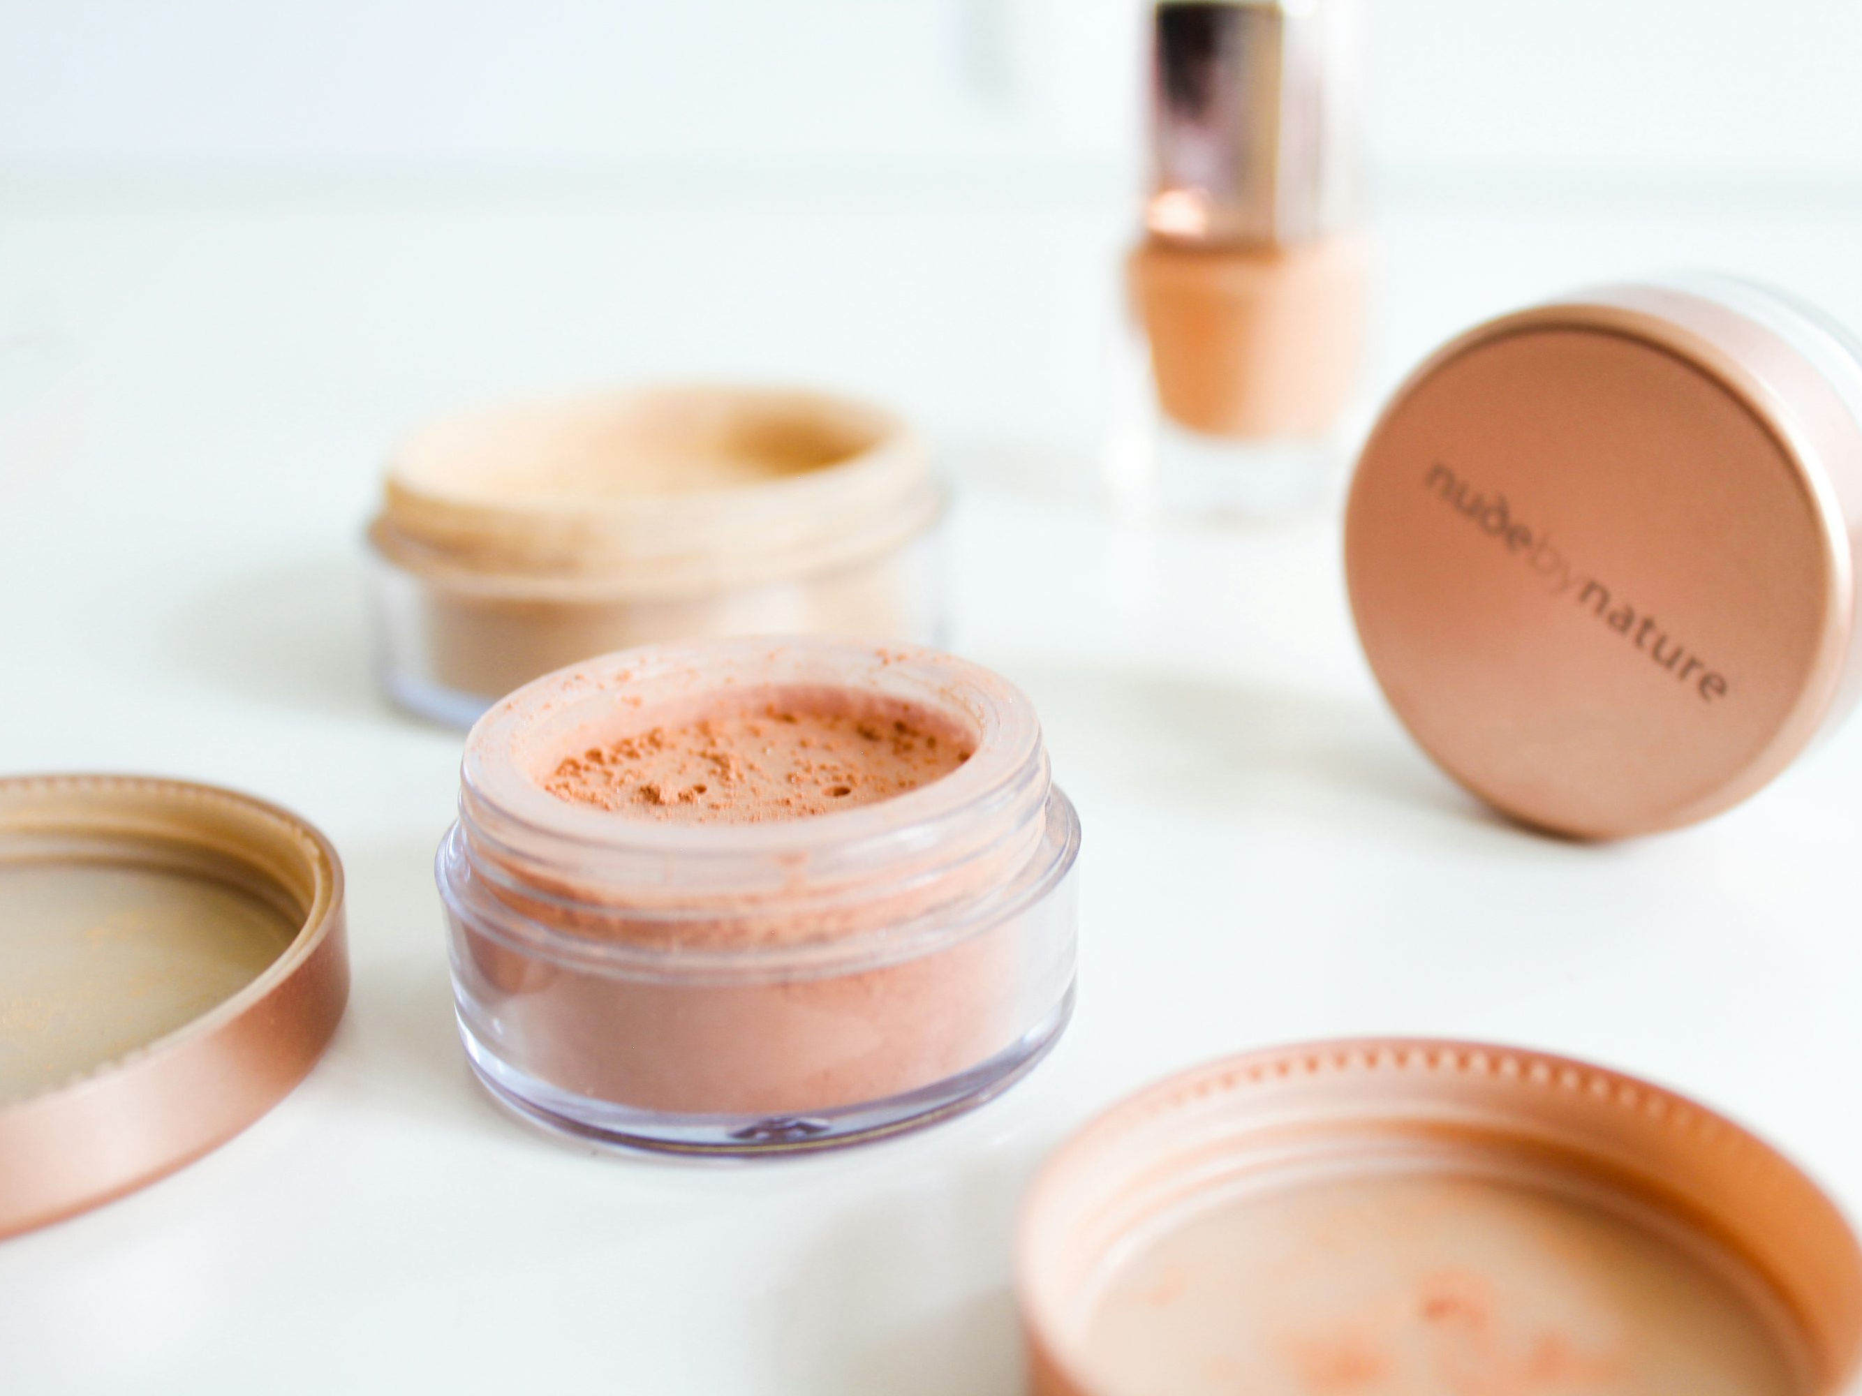
Over the last decade, the U.S. beauty market grew to $124B, with prestige categories leading the way
3-7% CAGR driven by premiumization, disruption from indies, and the rise of influencer- and social-driven discovery
Category
Market size
CAGR
▲ Share gainers
▼ Share losers
Personal Care
$42B
+4%
Functional wellness brands with differentiated propositions & branding
Conventional, commodity brands
Skincare
$28B
+5%
Indie disruptors, derma-backed lines & biotech entrants
Legacy brands with primary reliance on brand name
Makeup
$21B
+3%
Trend-focused brands maximizing new sub-categories and formats
Non-trend-focused heritage brands
Haircare
$18B
+4%
Expert-backed, stylist-founded brands with advanced salon-style treatments & actives
Non-differentiated mass-market & drugstore brands
Fragrance
$15B
+7%
Sensory, experience-led brands integrating fragrance into lifestyle & wellness
Cross-category players & mid-tier price points
Source: Kearney Prestige Beauty Consumer Index, January 2026

Slide 4
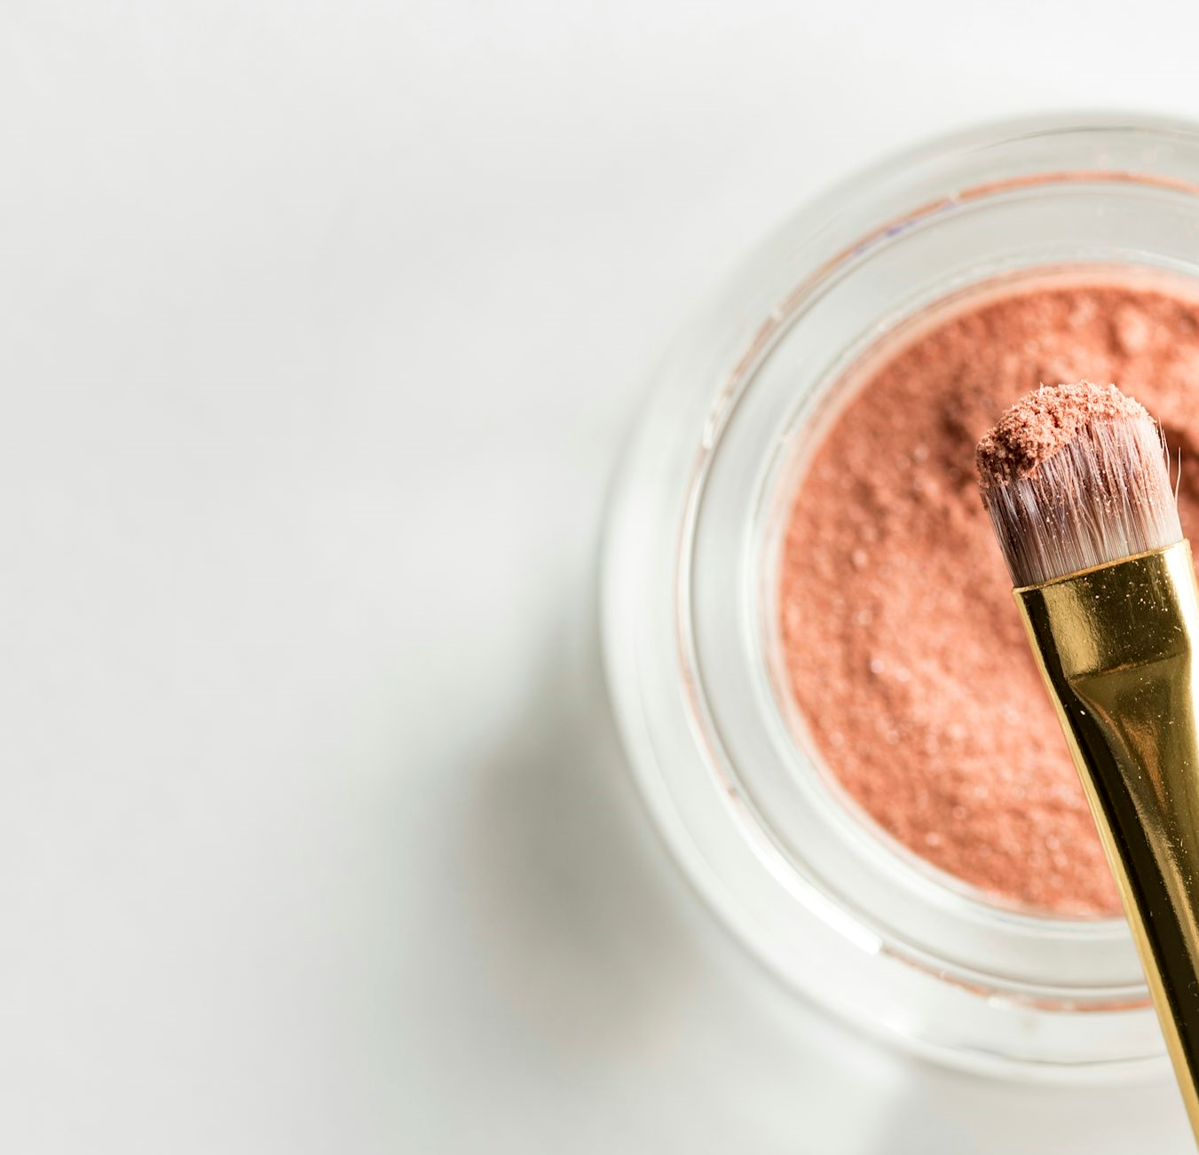
Over the next 5 years, beauty will remain resilient in the context of economic uncertainly — even as broader discretionary spend contracts
Beauty is a source of self-care, confidence, and everyday well-being — making it structurally protected spend
46%
of consumers plan to cut
discretionary spend in near term
Likely to spend less (in economic uncertainty) – By Category
Likely to spend less
Unlikely to spend less
Beauty & Personal Care
44%
38%
Health (Supplements)
40%
41%
Beauty & health are cut last
Consumers trim ‘luxury’ goods, electronics and travel first, but protect their health and beauty spend above all else.
Entertainment
52%
27%
Apparel & Accessories
55%
25%
Beauty's role is emotional, not just functional
It is a source of self-care, confidence, and everyday well-being
Travel & Vacation
60%
21%
Furniture / Electronics
60%
19%
Luxury Goods & Jewelry
67%
16%
However, consumers will be more discerning with beauty purchases — even more focused on performance, price justification, and credible proof
Source: Kearney Prestige Beauty Consumer Index, January 2026
4

Slide 5
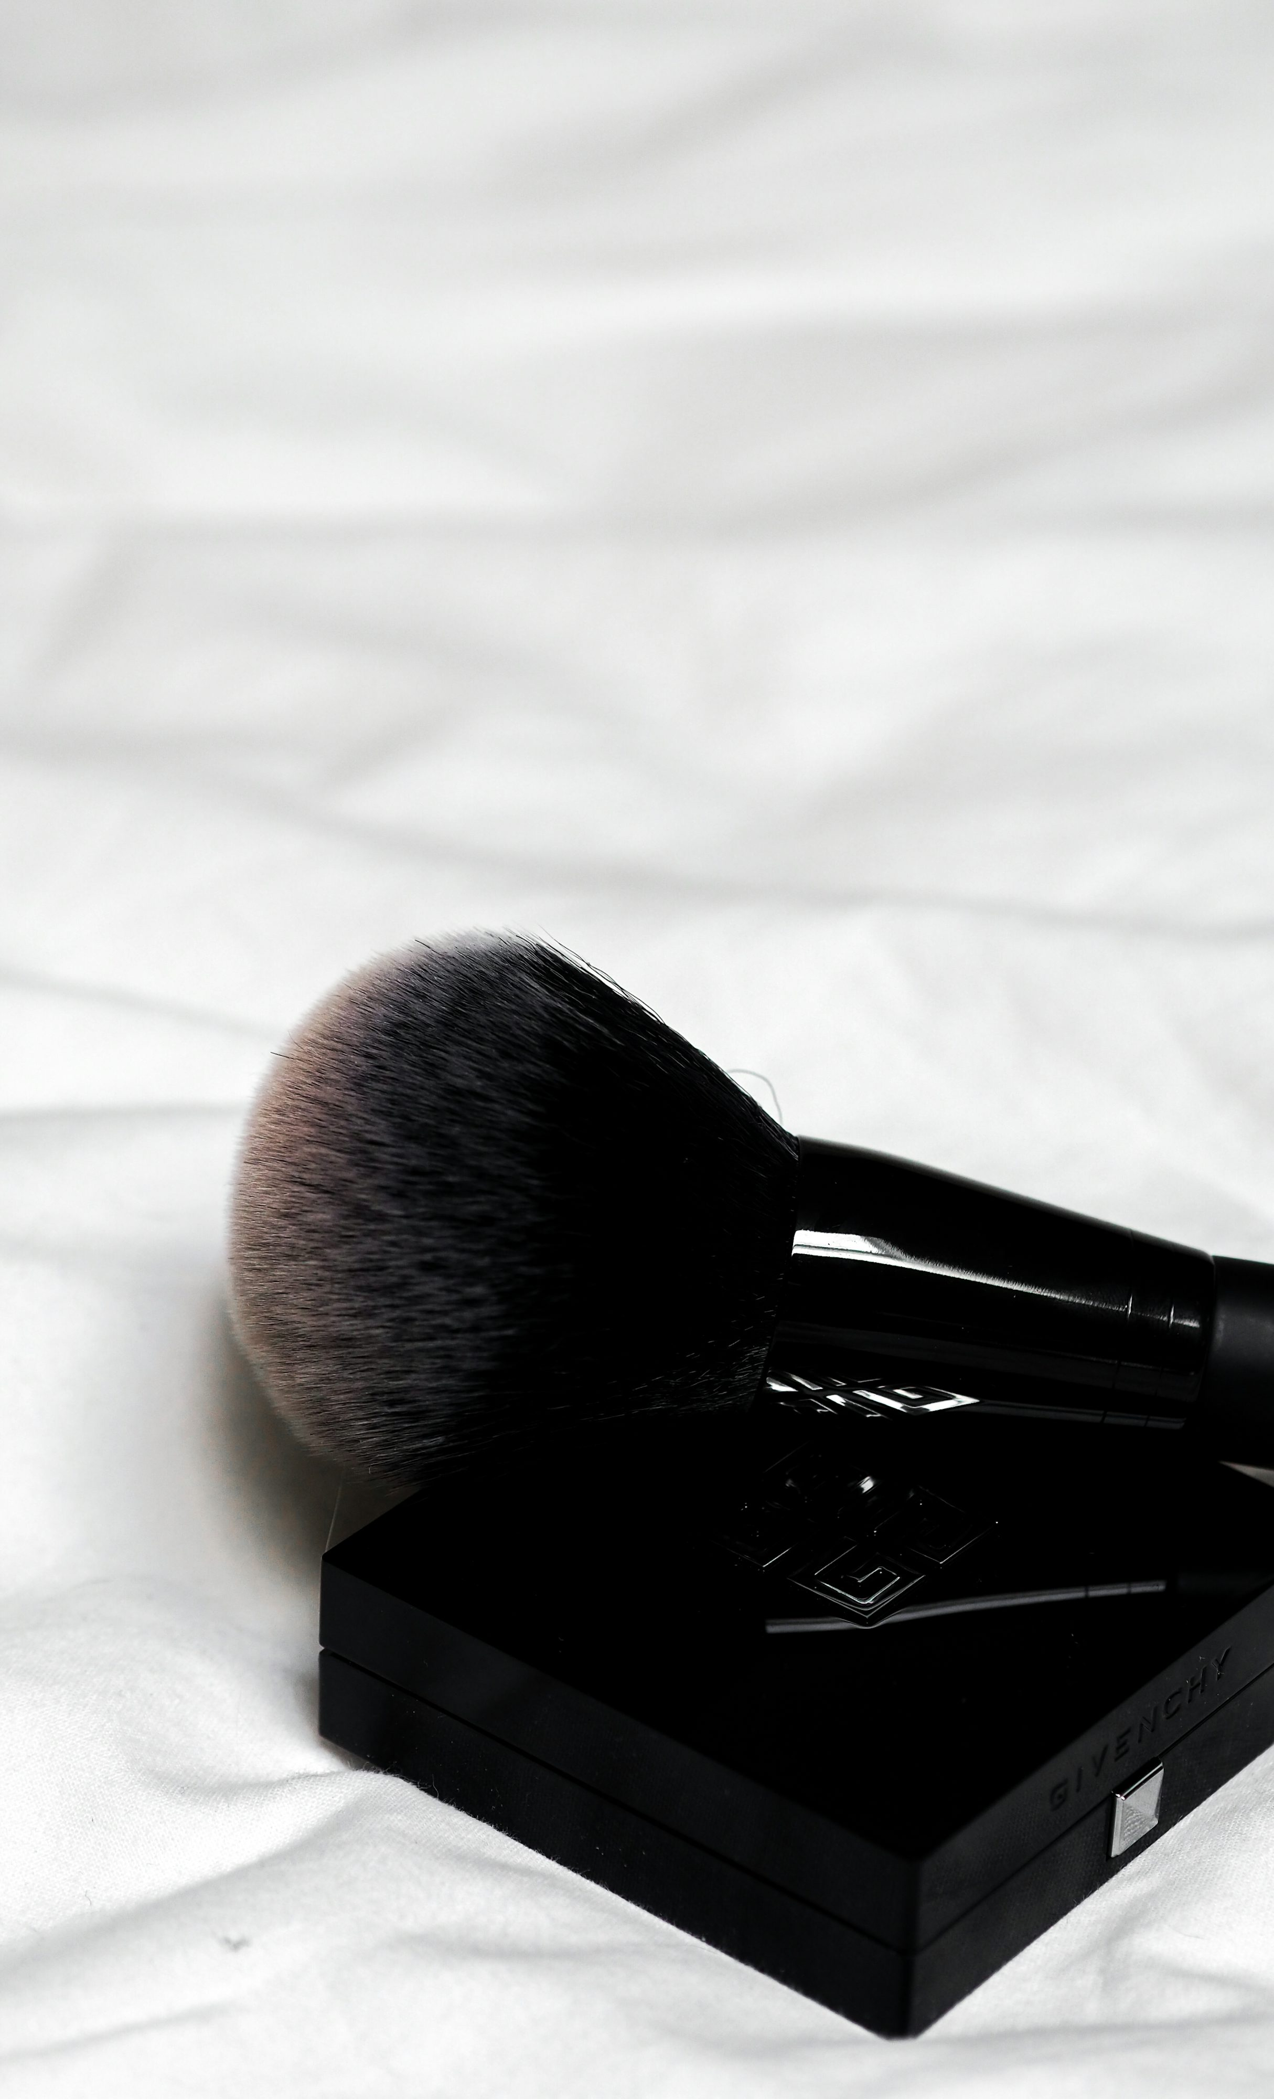
Five consumer personas define the U.S. beauty market — from Minimalist Savers to Confident Trend-Seekers
Built from a survey of 1,000 U.S. beauty consumers across generations and spending levels
Share of Survey
Avg monthly Spend
Demographic
Profile
Minimalist Savers
21%
$78
Boomers / Gen X, budget-focused
"My routine is simple – just the basics. I always check for good deals before I buy"
Routine Enthusiasts
13%
$164
Younger Millennial, female, diverse
"Every morning is the same; cleanser, SPF, done. I like products that fit into my routine"
Balanced Beautifiers
29%
$185
Millennial / Gen X mix
"I enjoy trying new brands if they fit my style and budget. Good skincare feels like a treat"
Premium Purists
22%
$216
Younger Millennial / Gen Z, diverse, female
"I invest in products that feel luxurious and support well-being. Quality matters"
Confident Trend-Seekers
15%
$257
Gen Z / Millennial, diverse, trend-leading
"I love bold looks and exploring the latest launches. My friends always ask where I shop"
Source: Kearney Prestige Beauty Consumer Index, January 2026

Slide 6
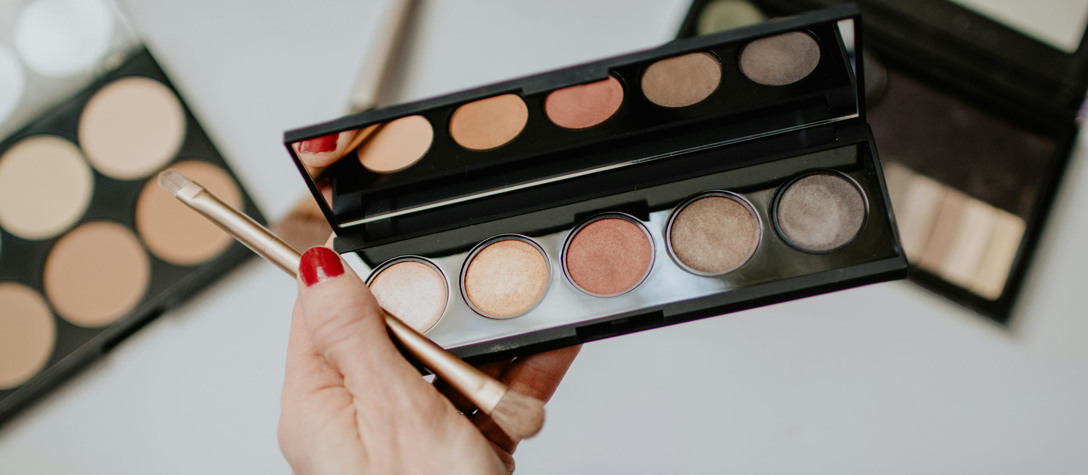
How to win each persona — a luxury brand's field guide
What drives each consumer — and exactly how luxury brands should engage them
What drives them
How to win them
What to avoid
Minimalist Savers
Price & value above all
Efficacy over brand name
Low-friction, fast shopping
Clear proof of results at accessible price points.
Hero SKUs with visible performance.
Fast reorder paths.
Over-investing in experience — they won't engage
Retain selectively
$78 avg/mo
Routine Enthusiasts
Routine & consistency
Clean formulas
Brand trust over time
Subscription formats, refills, routine bundles.
Make it effortless to stay loyal.
Novelty-first launches — they want reliability, not hype
Build loyalty
$164 avg/mo
Balanced Beautifiers
Quality + price balance
Trend-curiosity
Self-treat mentality
Editorial storytelling, accessible luxury cues, new format launches at justified price points.
Price increases without clear value narrative
Largest segment — earn share
$185 avg/mo
Premium Purists
Premium quality & ethics
Wellness integration
Science-backed claims
Immersive in-store ritual, science-forward positioning, wellness adjacency.
Make them feel seen.
Loud logo plays or price-led promotions
Core luxury target
$216 avg/mo
Confident Trend-Seekers
Innovation & novelty
Social currency
Dupe-aware but aspirational
Creator partnerships, limited edition drops, early access.
Make them the first to know.
Slow product cycles or invisible launches — they move at speed
Highest spend — activate now
$257 avg/mo
Source: Kearney Prestige Beauty Consumer Index, January 2026

Slide 7
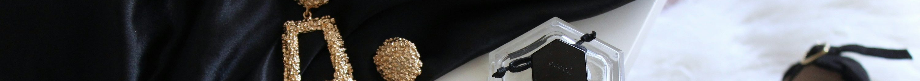




The New Rules of Luxury, Seen Through Beauty
Four shifts in beauty consumer behavior and what they reveal about the future of luxury
01
02
03
04
Loyalty Redefined
Efficacy as Baseline
Wellness
The Channel Battleground
From brand to SKU-level loyalty
Science and proof drive decisions
The new anchor role for beauty
Full funnel, four pillars
Functional loyalty is winning: Only 22% prioritize brand heritage/legacy vs. 44% efficacy
‘Dupe’ing’ is normalized: Dupes are now mainstream (44–62% actively looking for/using), pushing loyalty to be re-earned by product
Proof is the price of entry: 85% rank “higher quality/ ingredients” as important, ahead of price and reviews
Innovation only matters when it validates results: 80%+ say scientific validation influences what they buy. Science is the decision trigger, not “newness”
Wellness is the anchor role: “Self-care / feel healthy/well” is a leading buy-rationale across personas (37–47%)
For many, beauty plays a ritualistic role: Nearly 50% of the large wallet personas say beauty serves both health and daily indulgence/self-care
Consumers are consistently evaluating beauty channels on four pillars: curation (47%), community (44%), experience (41%), and convenience (37%)
One platform is leading the journey end-to-end: Amazon is the top destination for discovery, research, purchase and replenishment (40% - 50% across all)
7
Source: Kearney Prestige Beauty Consumer Index, January 2026

Slide 8
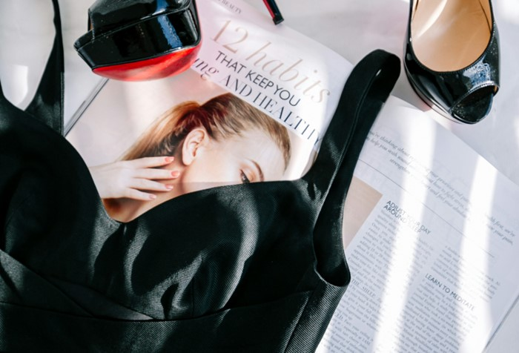
Loyalty Redefined:
Quality & efficacy dominate — brand heritage ranks near the bottom
01
Only 22% prioritize brand heritage vs. 48% quality and 44% efficacy — a signal every luxury brand must hear
89%
Rank quality/efficacy as important
Takeaways for luxury sectors
85%
Loyalty now lives at the SKU level, not the brand level
Rank price as important
In beauty: Brand heritage ranks 9th of 13 purchase drivers. Consumers switch freely when a product - not brand - fails to deliver.
59%
Rank brand heritage as important
Importance of attribute in consumer decision making
% of respondents
Consumers aren’t just loyal to houses anymore
Quality/Efficacy
89%
Price
85%
Your weakest product will not succeed on brand alone. The brand opens the door — the product has to close it. Every SKU is now a loyalty moment.
Benefits
84%
Inclusivity
73%
Clean Formulation
73%
Innovative Technology
67%
Price increases require a product-level story, not just a brand-level one
Sustainable & Ethical Sourcing
64%
Social Impact & Brand Purpose
60%
Recommended by friends or family
60%
Brand Heritage & Legacy
59%
US consumer confidence hit its lowest since May 2020 in April 2025. A X% price increase demands a X% stronger product story — brand story alone is not sufficient
Community
54%
Social Relevance & Trendiness
47%
Exclusivity
46%
Recommended by an influencer
Source: Kearney Prestige Beauty Consumer Index + Kearney Global State of Luxury 2026
39%

Slide 9
Loyalty Redefined:
Dupe culture is mainstream — and your highest-spending consumers are leading it
01
Personas with the deepest wallets are most actively seeking and satisfied with dupes
44–62%
of all consumers actively look for or use dupes
Takeaways for luxury sectors
Across every spending tier — not just budget shoppers
62%
Your best customers are actively questioning whether premium is worth it
of Confident Trend-Seekers actively dupe
The highest-spending persona is most dupe-active
In beauty: 62% of the highest-spending persona actively seeks dupes — ‘dupe’ing’ is mainstream
54%
would buy pre-owned directly from a luxury brand
Dupe behaviour by persona — % of each group
Resale is a strategic segment, not a threat to contain
14%
17%
21%
21%
Actively look for Dupes
Resale penetration is 4x higher among Gen Z and Millennials. Trade-up timelines are 3x longer.
30%
30%
41%
38%
38%
Tried Dupes and satisfied
32%
Pricing ladders are now a retention tool, not a dilution risk
56%
Accessible formats, minis, and entry SKUs have become very important. The question isn't 'will this cheapen the brand?' — it's 'what happens if we don't offer a way in?'
42%
41%
41%
38%
Other
Minimalist
Savers
Routine
Enthusiasts
Balanced
Beautifiers
Premium
Purists
Confident
Trend-Seekers
Source: Kearney Prestige Beauty Consumer Index + Kearney Global State of Luxury 2026

Slide 10
Efficacy as Baseline:
Price & effectiveness remain the most widespread unmet needs
02
Consumers judge every purchase on 'does it work for the price' — proof of performance is now the price of consideration
Areas of most unmet needs - % by beauty category
Takeaways for luxury sectors
Haircare
Skincare
Makeup
Fragrance
'Does it work for the price?' is now luxury's litmus test
I.
Price
Not available in right price range
29%
36%
33%
32%
In beauty: Price and efficacy are the top two unmet needs across every beauty category
II.
Efficacy
Products aren't effective enough
33%
31%
28%
26%
Performance expectations have separated from price
You have to win on both price premium and quality premium independently — a high price without a demonstrable performance is a hard test to pass
III.
Benefits
Doesn't have the right benefits
28%
32%
26%
21%
Jewelry performance in 2025 is a good proxy reason
Durability and resale value are proof points that jewelry can articulate clearly. What are other verifiable premiums?
IV.
Brand Values
Brand doesn’t speak to me
18%
22%
24%
31%
Consumer literacy leaves little space for error
Brands with an unclear price-performance proposition are filtered out fast — especially as Gen Z and Millennials apply beauty-level scrutiny to other luxury categories
Source: Kearney Prestige Beauty Consumer Index + Kearney Global State of Luxury 2026

Slide 11
Wellness:
Self-care and identity are the #1 reason consumers buy beauty — overtaking appearance
03
Wellness dominates across all 5 personas — beauty is bought for how it makes you feel, not just how you look
Takeaways for luxury sectors
37–47%
cite wellness as their primary purchase driver
Across every income level
The purchase rationale has turned inward. Consumers are buying for self, not for signal
~50%
In beauty: Wellness overtakes appearance as the #1 purchase driver across all 5 personas
of Premium Purists & Trend-Seekers call beauty ritualistic
Reasons to buy/use beauty products - % by each group
Consumers are buying to feel good, not impress
Appearance
Identity
Wellness ↑
The new brief is - make me ‘feel’ like the person I want to be
Minimalist Savers
22%
18%
37%
Routine Enthusiasts
26%
24%
42%
Experiences are winning for their emotional role
Balanced Beautifiers
30%
29%
37%
38% of US luxury consumers are spending less on goods and more on services for internal reward. Goods must now compete on emotional ROI, not just aesthetics
Premium Purists
36%
29%
47%
Brands with products with an inner story are winning
Confident
Trend-Seekers
32%
37%
43%
Brands like Cucinelli sell a philosophy of living — restraint, craft, timelessness — that consumers internalize as identity, not status.
Source: Kearney Prestige Beauty Consumer Index + Kearney Global State of Luxury 2026

Slide 12
The Channel Battleground:
Amazon dominates every stage of the beauty funnel
04
What began as a replenishment platform is now the primary destination for discovery, research, purchase and replenishment
Channels to discover, research, purchase, replenish new beauty products, trends, brands - % by respondents
Takeaways for luxury sectors
Digital discovery is increasingly the first store, and most luxury brands are absent
Discovery
Research
Purchase
Replenish
Amazon
42%
44%
45%
46%
In beauty: Amazon owns 42–46% of the beauty funnel at every stage.
Sephora
33%
35%
37%
34%
Physical retail has become the confirmation point
Brand.com
29%
32%
28%
32%
US luxury stores continue to shift from transaction to theatre (events, VIPs).
Often, the brand needs to win digitally first.
Google
28%
33%
20%
23%
Amazon's dominance is built on consistency, not excellence in any one area
Dept Store
23%
23%
26%
22%
Amazon isn't the best luxury experience, the best curator, or the most trusted community, but it is consistently good at all
Brand Store
21%
18%
18%
18%
Source: Kearney Prestige Beauty Consumer Index + Kearney Global State of Luxury 2026

Slide 13
The Channel Battleground:
Consumers judge every channel on the same four pillars
04
Whether online or in-store, consumers apply identical criteria — the channel hierarchy has collapsed
Criteria for evaluating beauty sales channels
– % of respondents
Takeaways for luxury sectors
Curation
Consumers no longer trade off pillars.
A gap in any one can disqualify the entire channel
Wide yet relevant assortment — consumers want choice without overwhelm, with clear 'what's right for me' guidance at every price point
Includes: Assortment breadth, clear navigation, personalised discovery
47%
customer importance
In beauty: The same 4 criteria are applied with equal weight across Amazon, Sephora, TikTok and stores.
Community
Trusted validation that reduces purchase risk — peer ratings, word-of-mouth, and credible feedback that feels authentic and easy to access
Includes: Peer reviews, word-of-mouth, authentic consumer feedback
A weak pillar doesn't drag down the average; it ends the consideration
44%
customer importance
A channel that fails on Convenience loses the replenishment shopper, even with great Experience
Experience
An engaging, intuitive journey that makes shopping feel inspiring — not transactional. Equally important online and in-store
Includes: Inspiration, confident decision support, a flow that 'feels good'
41%
customer importance
Experience and Community are the two pillars where luxury can genuinely differentiate
Convenience
Curation and Convenience are increasingly commoditized by platforms. The boutique, the stylist, the private event, the VIC network are your defensible moat
Speed and ease across the entire journey — from search to checkout to delivery to returns. Low-effort access is now a baseline expectation, not a premium
Includes: Frictionless checkout, fast delivery and returns, easy replenishment
37%
customer importance
Your most vulnerable pillar may be Convenience
Source: Kearney Prestige Beauty Consumer Index + Kearney Global State of Luxury 2026
Watchout from under-investing in post-purchase. Friction at any stage will be considered a brand failure

Slide 14
Final Thoughts
Taking a cue from Beauty, winning with today’s luxury consumers requires brands to:
Earn loyalty at the SKU level
Pass the 'Does it work for the price?’ check
Compete for their identify share – not just their wallet share
Win consideration before the consumer walks in and throughout

Slide 15






