Slide 1

Milton Pedraza, CEO, Luxury Institute

Slide 2
Luxury Institute
Over the past 22 years, Luxury Institute has served more than 1,100 luxury and premium brands through advanced research, consulting, and training solutions developed by leading industry experts.
Maintain the largest global network of luxury executives, experts, and high-net-worth (HNW) and ultra-high-net-worth (UHNW) individuals and families.
Conducts more quantitative and qualitative research with affluent, HNW, and UHNW consumers than any other organization, shaping how luxury brands engage and serve these clients.
Its proprietary education system, Luxcelerate, and online program – The Mastery of HNW Client Relationships – enhance emotional and relational intelligence as well as self-mastery for superior relationship-building performance.
Through research and training initiatives, Luxury Institute enables brands to deliver exceptional client experiences, cultivate lasting relationships, and drive measurable business growth.

Slide 3
Confidentiality
This presentation contains proprietary insights, examples, and strategic perspectives shared exclusively for the purpose of today’s session. The information provided is confidential and intended solely for the attendees of this event. It may not be copied, recorded, distributed, or used for any other purpose without prior written permission. By participating in this session, you agree to maintain the confidentiality of all content and discussions.

Slide 4
OUR SERVICES
LUXURY INTELLIGENCE RESEARCH
GLOBAL LUXURY EXPERT NETWORK (GLEN) SOLUTIONS
LUXCELERATE: HIGH-PERFORMANCE RELATIONSHIP BUILDING TRAINING SYSTEM
THE MASTERY OF HNW CLIENT RELATIONSHIPS: AN ONLINE COURSE
SPEAKING ENGAGEMENTS, PRESENTATIONS & WORKSHOPS
CONSULTING WITH THE STARS

Slide 5

2026 Luxury Forecast -
Top 4 Macroeconomic Factors That Could Dampen Growth
Slowing global economic growth and weakened consumer confidence (especially China, US, Europe)
High interest rates, inflation, and tighter credit reducing discretionary spending
Geopolitical instability (wars, elections, tariffs, trade fragmentation)
AI Bubble and the commodification of AI precipitates a stock market decline impacting wealth and spending levels

Slide 6
2026 Luxury Forecast -
Top 3 Macroeconomic Factors That Could Enhance Growth
Rising wealth concentration among HNW and UHNW individuals inspires continued spending
Recovery of global travel and cross-border tourism spending
Consumers buying fewer yet higher-quality luxury items create a trading up effect

Slide 7
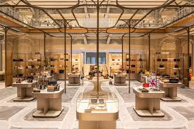
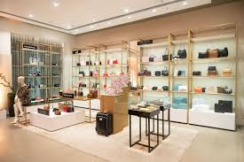
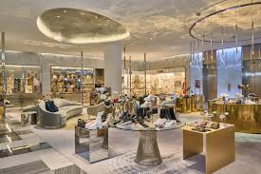
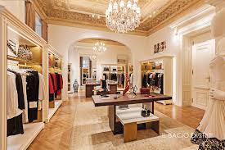
Department Store Retail
Predicted Trajectory: Slightly Up
Key Indicators:
  Shift toward experience-led, curated retail environments
  Concentration of spending among affluent, HNW, and UHNW clients
  Uneven performance due to competition from mono-brand stores and e-commerce
Opportunities:
  Reinvention as curated, experience-led and entertainment destinations strengthens brand storytelling and client acquisition/retention
  The multi-brand appeal of department stores remains compelling or becomes even more compelling as they elevate the curation and client experience
Risks:
  The direct-to-consumer strategy of luxury brands minimizes the relevance of traditional department store formats
  Department stores may not have access to the best products and offerings from the best luxury brands

Slide 8
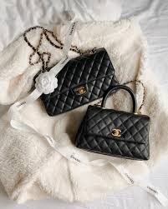
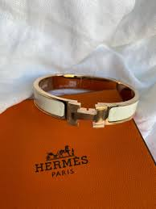
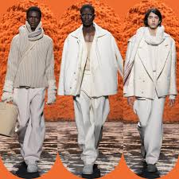
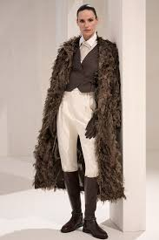
Apparel & Accessories
Predicted Trajectory: Slightly Up
Key Indicators:
  Timeless demand for fashion, accessories, and seasonal newness
  Strong tourism-driven sales in key global cities
  Growth in emerging markets and younger affluent consumers
Opportunities:
  Continued demand driven by tourism and fashion renewal cycles
  Younger affluent consumers fuel selective growth in trend-relevant brands
Risks:
  Fashion fatigue, sameness, and over-saturation reduce urgency and full-price conversion
  High price increases intensify consumer scrutiny and trade-down behavior

Slide 9
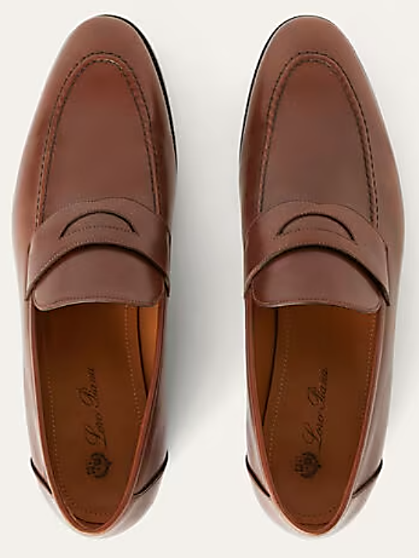
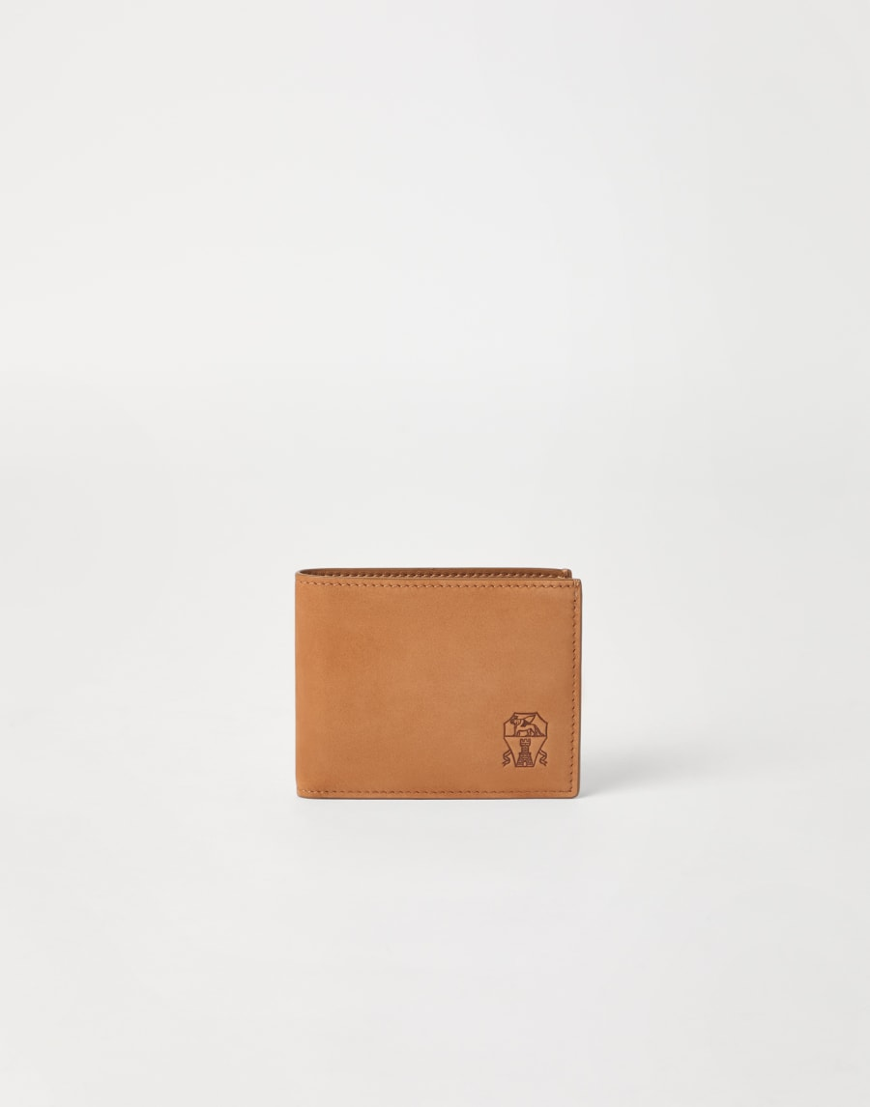
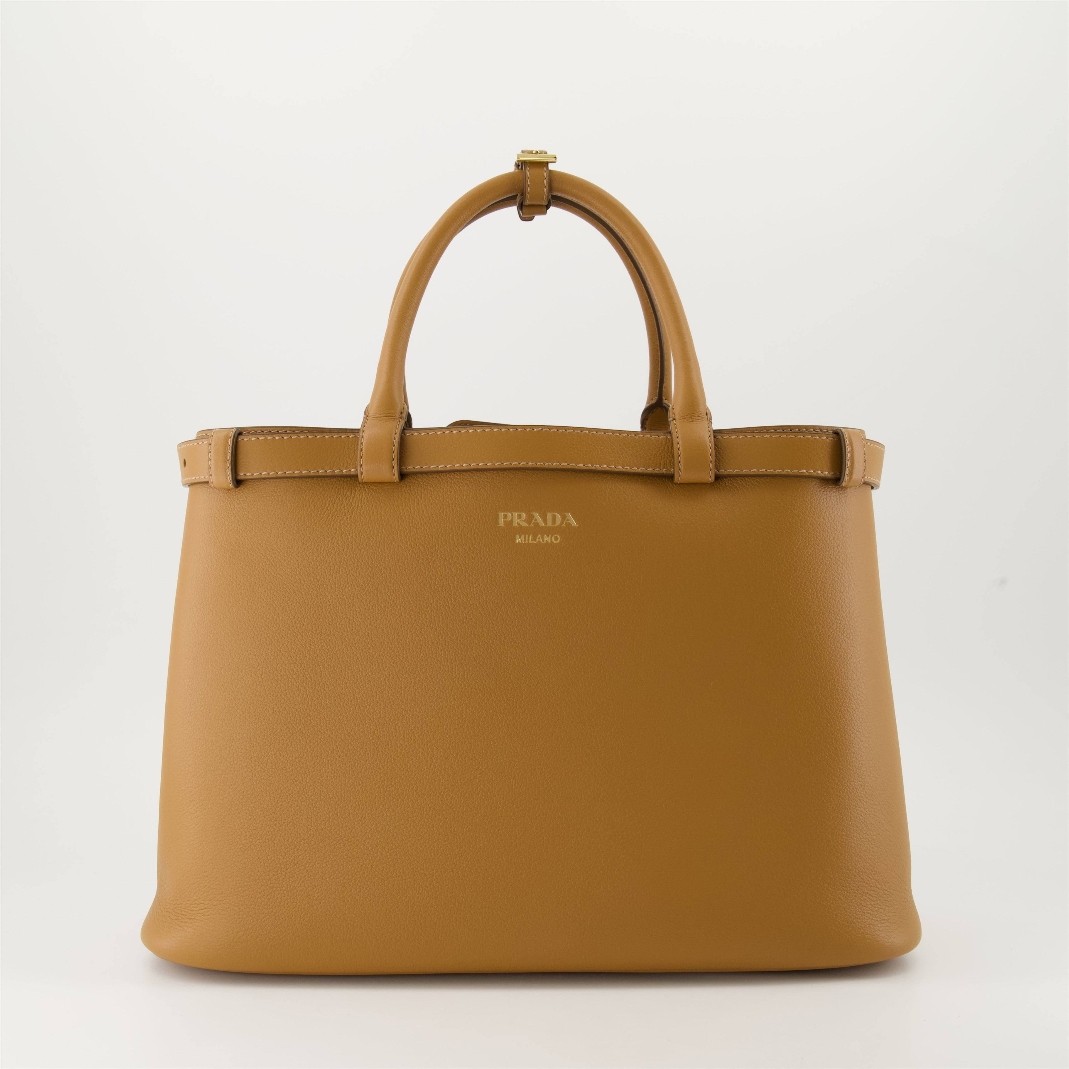
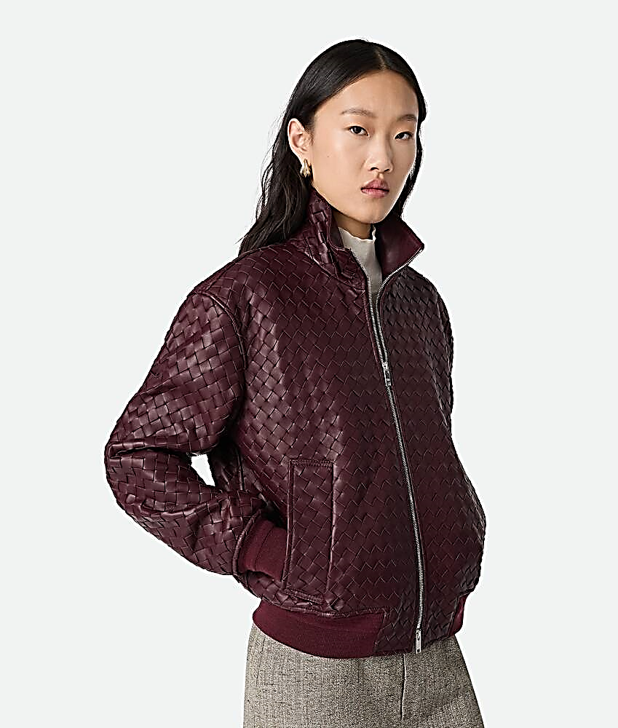
Leather Goods
Predicted Trajectory: Slightly Up
Key Indicators:
  Leather goods remain the most essential, desired, and affordable category
  Strong brand equity, storytelling, and limited editions sustain demand
  Selective purchasing due to pricing pressure, sustainability concerns, and potential resale value
Opportunities:
  Leather goods remain a primary entry point and gifting category into luxury
  Iconic designs and limited editions reinforce long-term desirability and resale value
Risks:
  Pricing pressure risks breaking perceived value thresholds
  Sustainability concerns and resale transparency expose overproduction

Slide 10



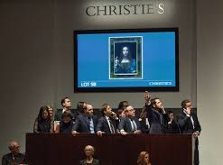
Art & Auctions
Predicted Trajectory: Slightly Up
Key Indicators:
  Art as an alternative investment and store of value for wealthy buyers as a diversification strategy
  Expansion of younger, global, and digital-first collectors
  Measured pace due to economic uncertainty and selective high-value buying
Opportunities:
  Art’s role as an alternative investment attracts wealthy, global buyers
  Younger and digital-first collectors expand the buyer base
Risks:
  Economic uncertainty reduces investment buying
  Market concentration at the very top limits volume growth

Slide 11
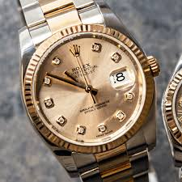

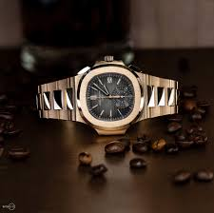
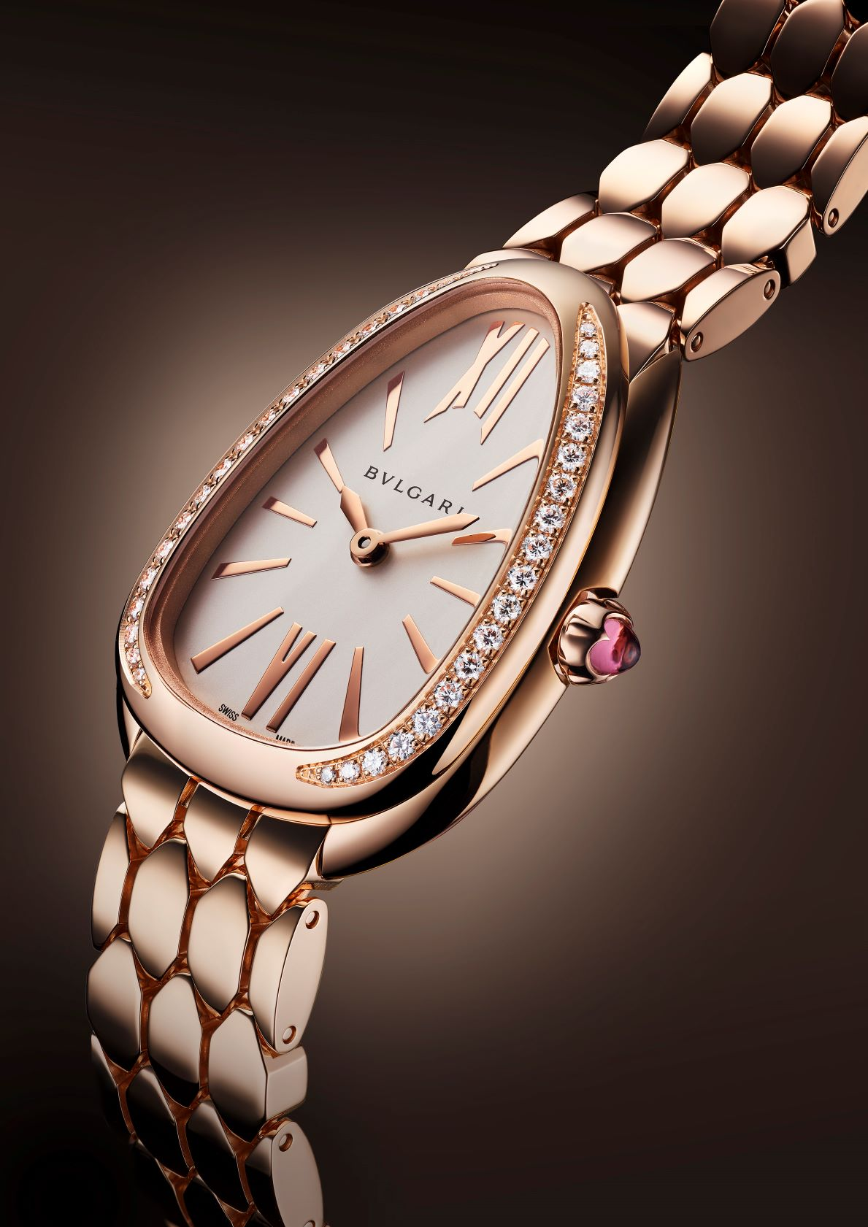
Watches
Predicted Trajectory: Slightly Up
Key Indicators:
  Enduring appeal of heritage, craftsmanship, and mechanical timepieces
  Continued strong collector demand and investment perception
  Moderating factors: pricing volatility, resale market impact, and economic pressure
Opportunities:
  Enduring demand for mechanical craftsmanship and heritage timepieces combined with innovative new offerings
  Strong collector and investment appeal for scarce pieces
Risks:
  Secondary market volatility undermines pricing credibility
  Cooling hype cycles reduce demand for non-iconic models

Slide 12
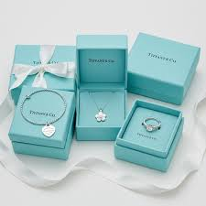

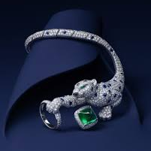

Jewelry
Predicted Trajectory: Slightly Up
Key Indicators:
  Jewelry viewed as both emotional and financial asset
  Cultural relevance, gifting traditions, and personalization
  Growth in affluent populations despite price sensitivity in some markets
Opportunities:
  Jewelry’s dual role as emotional symbol and financial asset strengthens resilience
  Cultural gifting traditions support steady global demand
Risks:
  Price sensitivity rises amid high gold and gemstone costs
  Over-saturation and sameness risk weakening exclusivity and demand

Slide 13
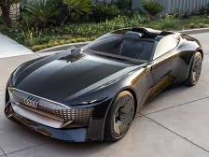


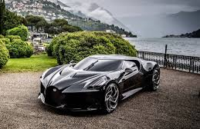
Cars
Predicted Trajectory: Slightly Up
Key Indicators:
  Rising global wealth and demand in emerging markets
  Electrification and technological innovation attracting affluent buyers despite slower adoption across the industry
  Longer replacement cycles, cautious sentiment, tariffs, and higher borrowing rates moderating volume growth
Opportunities:
  Electrification and innovation attract new affluent and sustainability-conscious buyers
  Emerging markets drive long-term demand growth
Risks:
  Longer replacement cycles slow volume growth
  Regulatory and sustainability pressures raise costs and complexity
  Chinese domination of electric cars threatens all auto segments

Slide 14

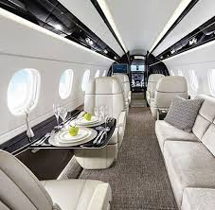
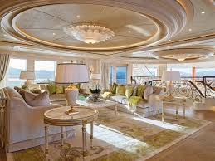

Jets and Yachts
Predicted Trajectory: Significantly Up
Key Indicators:
  Rising UHNW population and demand for privacy, control of time and space, and autonomy
  Growth in experiential and lifestyle-driven luxury spending
  Continued resilience at the very top end despite economic volatility
  Private aviation has become a commodity among UHNW
Opportunities:
  UHNW demand for privacy and autonomy supports continued growth
  Lifestyle-driven and experiential luxury spending remains strong
Risks:
  Potential stock market decline reduces demand from HNW and marginally UHNW consumers
  High capital costs limit market expansion beyond UHNW buyers

Slide 15




Real Estate
Predicted Trajectory: Slightly Up
Key Indicators:
  Luxury property as a safe-haven, long-term investment
  Limited supply in prime locations supporting prices
  Global affluent demand and intergenerational wealth transfer
Opportunities:
  Prime luxury property remains a safe-haven investment
  Supply scarcity in top locations supports pricing power
Risks:
  Interest rate volatility dampens transaction volume
  Regulatory constraints and foreign buyer restrictions reduce liquidity
  A growing shift toward accessing as opposed to owning luxury property

Slide 16
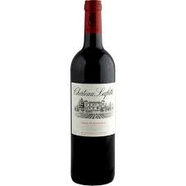
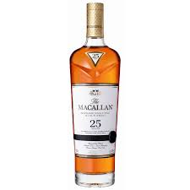
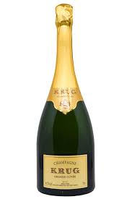
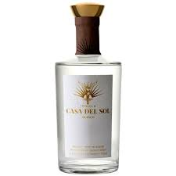
Wines & Spirits
Predicted Trajectory: Slightly Up
Key Indicators:
  Demand for high-quality, heritage brands continues
  Experiential consumption (tastings, gifting, collecting)
  Uneven regional performance due to tariffs, China softness, and restaurant pressure
Opportunities:
  Collectible categories drive value growth
  Experiential consumption (tastings, gifting, cellaring) enhances desirability
Risks:
  Tariffs, geopolitical tensions, and China softness hurt demand
  Younger (and older) consumers reduce alcohol consumption in some markets
  Emerging trends drive discounting in the industry
  Non-Alcoholic and low alcohol innovations are yet to be proven

Slide 17




Health & Wellness
Predicted Trajectory: Significantly Up
Key Indicators:
  Wellness, preventive healthcare, and healthy longevity as core luxury priorities for wealthy consumers
  Growth of legitimate experiential, medical, and personalized wellness offerings
  Strong overlap with luxury travel and lifestyle spending
Opportunities:
  Longevity, preventive healthcare, and wellness become core priorities beyond wealthy consumers
  Personalized, medical, and experiential wellness innovations scale rapidly
Risks:
  Market overcrowding dilutes differentiation and commodifies offerings
  Credibility risks if offerings lack scientific or experiential rigor

Slide 18
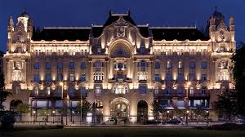

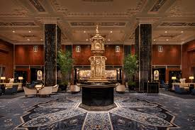

Travel & Hospitality
Predicted Trajectory: Significantly Up
Key Indicators:
  Strong rebound in global travel and experiential luxury demand
  Wealthy consumers prioritizing bespoke, immersive experiences including niche locations
  Merely affluent and aspirationals stretch to selectively purchase luxury travel and hospitality
Opportunities:
  Strong rebound in experiential and bespoke travel
  Limited supply allows premium pricing and margin expansion
  Medical travel to arbitrage costs
Risks:
  Geopolitical disruptions affect travel confidence
  Service talent shortages threaten experience quality
  Potential oversupply in certain cities and locations

Slide 19
Thank you, Mickey! & Thank you all for joining me today!

Slide 20
Contact: Milton Pedraza Luxury Institute CEO mpedraza@luxuryinstitute.com Jessica Lafferty Luxury Institute Consultant jlafferty@luxuryinstitute.com

